Slide 1
ECEG-5193: Algorithm Analysis and Design
Algorithm Design Techniques
Branch and Bound

Slide 2
Branch and Bound Searching Strategies

Slide 3
Feasible Solution vs. Optimal Solution
DFS, BFS, … can be used to solve some searching problem for searching a feasible solution.
However, they cannot be used to solve the optimization problems for searching an (the) optimal solution.

Slide 4
The branch-and-bound strategy
This strategy can be used to solve optimization problems without an exhaustive search in the average case.

Slide 5
Branch-and-bound strategy
Two Mechanisms:
A mechanism to generate branches when searching the solution space
A mechanism to generate a bound so that many branches can be terminated

Slide 6
Branch-and-bound strategy
It is efficient in the average case because many branches can be terminated very early.
Although it is usually very efficient, a very large tree may be generated in the worst case.
Many NP-hard problem can be solved by B&B efficiently in the average case; however, the worst case time complexity is still exponential.

Slide 7
For Minimization Problems
∞
Upper Bound (for feasible solutions)
Usually, LB<UB.
If LB≥UB, the expanding node can be terminated.
Optimal
Lower Bound (for expanding nods)
0

Slide 8
For Maximization Problems
∞
Upper Bound (for expanding nods)
Usually, LB<UB.
If LB≥UB, the expanding node can be terminated.
Optimal
Lower Bound (for feasible solutions)
0

Slide 9
Basic Branch and Bound
Goal: Find Optimal path from T to D
E
1
A
D
1
G
5
9
3
11
T
V
8

Slide 10
Basic Branch and Bound
Lower Bound:
8
9
10
11
13
15
T
8
9
1
E
8
9
V
A
A
D
3
11
1
1
1
5
11
19
G
D
10
10
9
G
E
G
T
11
5
5
3
3
15
13
16
D
D
V
8
V
3
11
16
24
G
D
Not Efficient

Slide 11
Branch and Bound
Prune infeasible paths
T
8
9
8
9
V
A
3
11
1
1
11
19
G
D
10
10
G
E
5
5
3
13
15
D
V
16
D
3
11
16
24
G
D

Slide 12
Branch and Bound
Prune infeasible paths
T
T
8
9
8
9
8
9
V
A
8
9
V
A
3
11
1
1
3
11
1
1
11
19
10
10
11
19
G
D
G
E
10
10
G
D
G
E
5
5
3
16
15
13
5
3
15
13
D
D
V
D
V
3
11
16
24
G
D

Slide 13
Integer programming
Example: maximizing a function with given constraints.
z= 3x +2y.
5x + 6y ≤ 45
4x + 7y ≤ 42
Solution: x = 5.73, y= 2.73

Slide 14
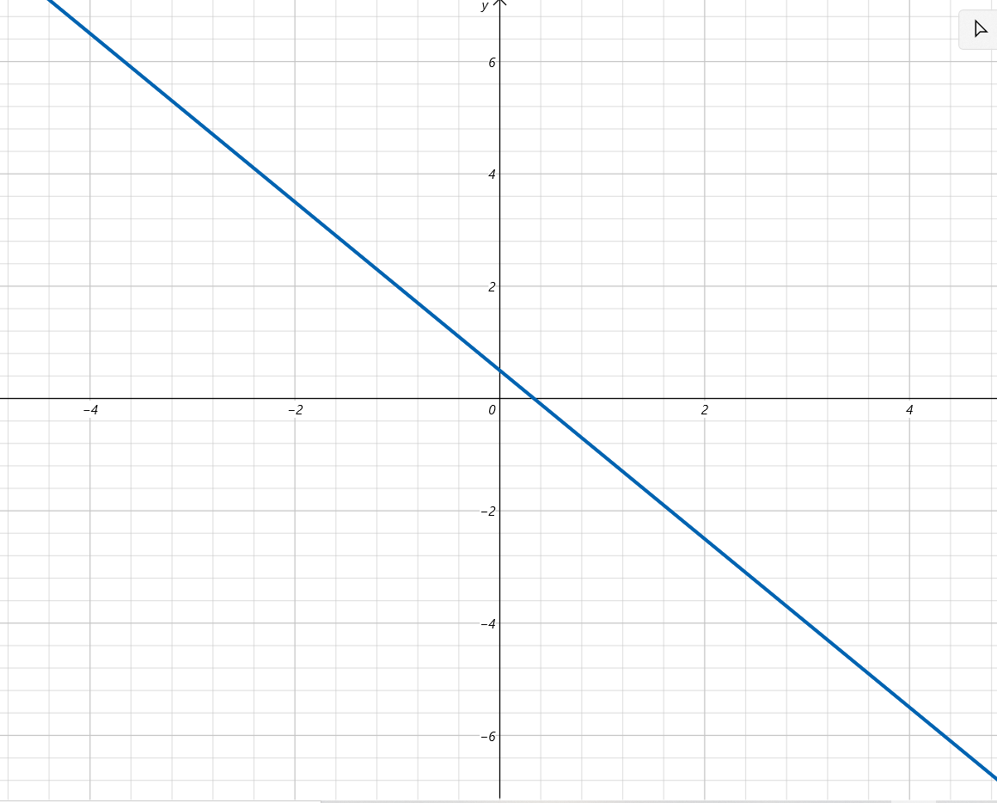
Integer programming
z = 3x +2y

Slide 15
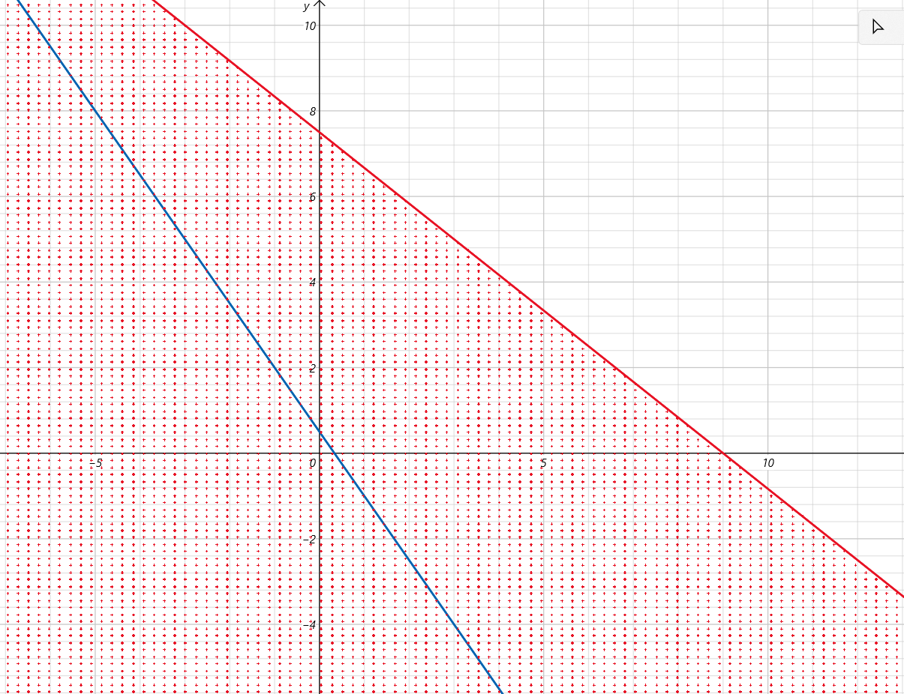
Integer programming
z = 3x +2y
5x + 6y ≤ 45

Slide 16
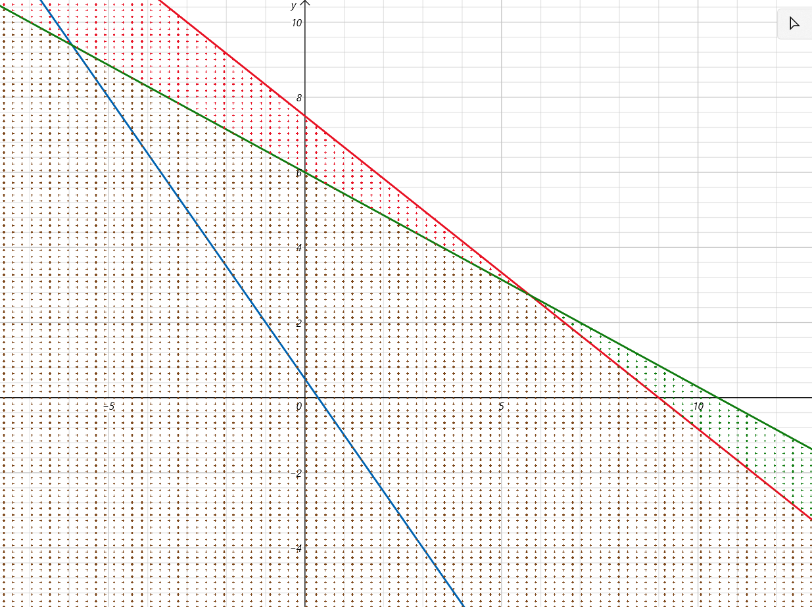
Integer programming
z = 3x +2y
5x + 6y ≤ 45
4x + 7y ≤ 42
6
x = 5.73
y = 2.73
4
2
0
5
10
How to find an integer solution?

Slide 17
Integer programming
z = 3x +2y
5x + 6y ≤ 45
4x + 7y ≤ 42
x = 5.73
y = 2.73
How to find an integer solution?
Let
x = 5 or 6
y = 2 or 3

Slide 18
Integer programming
z = 3x +2y
5x + 6y ≤ 45
4x + 7y ≤ 42
6
x = 5.73
y = 2.73
4
2
0
5
6
10
How to find an integer solution?

Slide 19
Integer programming
z = 3x +2y
5x + 6y ≤ 45
4x + 7y ≤ 42
x = 5.73
y = 2.73
z = 3x +2y
= 3*5.73) +2*2.73
= 22.65
We cannot do better than 22.65
Next best integer value is 22
Upper bound: 22
Lower bound:

Slide 20
Maximizing z with integers
z = 3x +2y
5x + 6y ≤ 45
4x + 7y ≤ 42
x = 5.73
y = 2.73
Upper bound:
Lower bound:
22
21.28
x = 5.73
y = 2.73
z = 22.65
x ≤ 5
x ≥ 6
x = 5
y = 2.73
z = 21.28
x = 6
y = 2.73
z = 17

Slide 21
Maximizing z with integers
z = 3x +2y
5x + 6y ≤ 45
4x + 7y ≤ 42
x = 5.73
y = 2.73
Upper bound:
Lower bound:
22
21.28
21
x = 5.73
y = 2.73
z = 22.65
x ≤ 5
x ≥ 6
x = 5
y = 2.73
z = 21.28
x = 6
y = 2.73
z = 17
y ≤ 3
y ≥ 4
x = 5
y = 3
z = 21
x = 5
y = 4
z =
5(5) + 6(4) = 49. Violates constraint

Slide 22
Maximizing z with integers
z = 3x +2y
5x + 6y ≤ 45
4x + 7y ≤ 42
x = 5.73
y = 2.73
Upper bound:
Lower bound:
22
21
x = 5.73
y = 2.73
z = 22.65
x ≤ 5
x ≥ 6
x = 5
y = 2.73
z = 21.28
x = 6
y = 2.73
z = 17
y ≤ 3
y ≥ 4
x = 5
y = 3
z = 21
x = 5
y = 4
z =
x ≤ 4
x = 4
y = 3
z = 18

Slide 23
Maximizing z with integers
z = 3x +2y
5x + 6y ≤ 45
4x + 7y ≤ 42
x = 5.73
y = 2.73
Upper bound:
Lower bound:
22
21
22
x = 5.73
y = 2.73
z = 22.65
x ≤ 5
x ≥ 6
x = 5
y = 2.73
z = 21.28
x = 6
y = 2.73
z = 17
y ≤ 3
y ≥ 4
x = 5
y = 3
z = 21
x = 5
y = 4
z =
y ≤ 2
y ≥ 3
x ≤ 4
x = 6
y = 2
z = 22
x = 6
y = 3
z =

x = 4
y = 3
z = 18
x = 6
y = 2
4(6) + 7(3) ≥ 42

Slide 24
Integer programming
z = 3x +2y
5x + 6y ≤ 45
4x + 7y ≤ 42
6
x = 6
y = 2
z = 22
4
2
0
5
6
10

Slide 25
The Traveling Salesman Problem
Given a graph, the TSP Optimization problem is to find a tour, starting from any vertex, visiting every other vertex (only once) and returning to the starting vertex, with minimal cost.
It is NP-hard.
We try to avoid n! exhaustive search by the branch-and-bound technique on the average case.
- O(n!) > O(2^{n})

Slide 26
The Traveling Salesman Problem
Example
Brute force
1
10
15
20
1
10
15
20
2
3
4
20
35
35
30
25
30
25
10
15
45
35
50
45
20
20
4
3
4
2
4
2
3
25
30
30
30
25
25
35
35
2
3
35
75
65
75
70
80
85
4
3
4
2
3
2

Slide 27
The Traveling Salesman Problem
Example - Using branch and bound
1
2
 | 1 | 2 | 3 | 4 | 5
1 | ∞ | 20 | 30 | 10 | 11
2 | 15 | ∞ | 16 | 4 | 2
3 | 3 | 5 | ∞ | 2 | 4
4 | 19 | 6 | 18 | ∞ | 3
5 | 16 | 4 | 7 | 16 | ∞
4
3
5

Slide 28
The basic idea
Split the solution space (branch)
Predict a lower bound for a class of solutions.
Find a upper bound of an optimal solution.
if the lower bound of a solution exceeds the upper bound, this solution cannot be optimal and thus we should terminate the branching associated with this solution.

Slide 29
The Traveling Salesman Problem
Step 1 reduce: Search each row to the smallest value
 | 1 | 2 | 3 | 4 | 5
1 | ∞ | 20 | 30 | 10 | 11
2 | 15 | ∞ | 16 | 4 | 2
3 | 3 | 5 | ∞ | 2 | 4
4 | 19 | 6 | 18 | ∞ | 3
5 | 16 | 4 | 7 | 16 | ∞
 | 1 | 2 | 3 | 4 | 5
1 | ∞ | 10 | 20 | 0 | 1
2 | 13 | ∞ | 14 | 2 | 0
3 | 1 | 3 | ∞ | 0 | 2
4 | 16 | 3 | 15 | ∞ | 0
5 | 12 | 0 | 3 | 12 | ∞
10
2
2
3
4
21

Slide 30
The Traveling Salesman Problem
Step 2 reduce: Search each column to the smallest value
 | 1 | 2 | 3 | 4 | 5
1 | ∞ | 10 | 20 | 0 | 1
2 | 13 | ∞ | 14 | 2 | 0
3 | 1 | 3 | ∞ | 0 | 2
4 | 16 | 3 | 15 | ∞ | 0
5 | 12 | 0 | 3 | 12 | ∞
 | 1 | 2 | 3 | 4 | 5
1 | ∞ | 10 | 17 | 0 | 1
2 | 12 | ∞ | 11 | 2 | 0
3 | 10 | 3 | ∞ | 0 | 2
4 | 15 | 3 | 12 | ∞ | 0
5 | 11 | 0 | 0 | 12 | ∞
1 | 0 | 3 | 0 | 0
4
Total reduction: 21 + 4 = 25
This is cost of the first node.

Slide 31
The Traveling Salesman Problem
UPPER BOUND:
∞
1
2
25
1
4
3
2
3
4
5
5
 | 1 | 2 | 3 | 4 | 5
1 | ∞ | 10 | 17 | 0 | 1
2 | 12 | ∞ | 11 | 2 | 0
3 | 0 | 3 | ∞ | 0 | 2
4 | 15 | 3 | 12 | ∞ | 0
5 | 11 | 0 | 0 | 12 | ∞
 | 1 | 2 | 3 | 4 | 5
1 | ∞ | ∞ | ∞ | ∞ | ∞
2 | ∞ | ∞ | 11 | 2 | 0
3 | 0 | ∞ | ∞ | 0 | 2
4 | 15 | ∞ | 12 | ∞ | 0
5 | 11 | ∞ | 0 | 12 | ∞
C(2) = C(1) + C(1,2) + r
C(2) = 25 + 10 + 0
C(2) = 35
r = 0

Slide 32
The Traveling Salesman Problem
UPPER BOUND:
∞
1
2
25
1
C(3) = C(1) + C(1,3) + r
4
3
35
C(3) = 25 + 17 + 11
2
3
4
5
C(3) = 53
5
 | 1 | 2 | 3 | 4 | 5
1 | ∞ | 10 | 17 | 0 | 1
2 | 12 | ∞ | 11 | 2 | 0
3 | 0 | 3 | ∞ | 0 | 2
4 | 15 | 3 | 12 | ∞ | 0
5 | 11 | 0 | 0 | 12 | ∞
 | 1 | 2 | 3 | 4 | 5
1 | ∞ | ∞ | ∞ | ∞ | ∞
2 | 12 | ∞ | ∞ | 2 | 0
3 | ∞ | 3 | ∞ | 0 | 2
4 | 15 | 3 | ∞ | ∞ | 0
5 | 11 | 0 | ∞ | 12 | ∞
 | 1 | 2 | 3 | 4 | 5
1 | ∞ | ∞ | ∞ | ∞ | ∞
2 | 1 | ∞ | ∞ | 2 | 0
3 | ∞ | 3 | ∞ | 0 | 2
4 | 4 | 3 | ∞ | ∞ | 0
5 | 0 | 0 | ∞ | 12 | ∞
11 | 0 | - | 0 | 0
r = 11

Slide 33
The Traveling Salesman Problem
UPPER BOUND:
∞
1
2
25
1
4
3
35
53
25
2
3
4
5
5
 | 1 | 2 | 3 | 4 | 5
1 | ∞ | 10 | 17 | 0 | 1
2 | 12 | ∞ | 11 | 2 | 0
3 | 0 | 3 | ∞ | 0 | 2
4 | 15 | 3 | 12 | ∞ | 0
5 | 11 | 0 | 0 | 12 | ∞
 | 1 | 2 | 3 | 4 | 5
1 | ∞ | ∞ | ∞ | ∞ | ∞
2 | 12 | ∞ | 11 | ∞ | 0
3 | 0 | 3 | ∞ | ∞ | 2
4 | ∞ | 3 | 12 | ∞ | 0
5 | 11 | 0 | 0 | ∞ | ∞
C(4) = C(1) + C(1,4) + r
C(4) = 25 + 0 + 0
C(4) = 25
r = 0

Slide 34
The Traveling Salesman Problem
UPPER BOUND:
∞
1
2
25
1
C(4) = C(1) + C(1,5) + r
4
3
35
53
25
31
C(4) = 25 + 1 + 5
2
3
4
5
5
C(4) = 31
 | 1 | 2 | 3 | 4 | 5
1 | ∞ | 10 | 17 | 0 | 1
2 | 12 | ∞ | 11 | 2 | 0
3 | 0 | 3 | ∞ | 0 | 2
4 | 15 | 3 | 12 | ∞ | 0
5 | 11 | 0 | 0 | 12 | ∞
 | 1 | 2 | 3 | 4 | 5
1 | ∞ | ∞ | ∞ | ∞ | ∞
2 | 12 | ∞ | 11 | 2 | ∞
3 | 0 | 3 | ∞ | 0 | ∞
4 | 15 | 3 | 12 | ∞ | ∞
5 | ∞ | 0 | 0 | 12 | ∞
 | 1 | 2 | 3 | 4 | 5
1 | ∞ | ∞ | ∞ | ∞ | ∞
2 | 10 | ∞ | 9 | 0 | ∞
3 | 0 | 3 | ∞ | 0 | ∞
4 | 12 | 0 | 9 | ∞ | ∞
5 | ∞ | 0 | 0 | 12 | ∞
-
2
0
3
0
0 | 0 | 0 | 0 | -
5
r = 5

Slide 35
The Traveling Salesman Problem
25
1
UPPER BOUND:
∞
1
2
35
53
25
31
2
3
4
5
4
3
5
28
2
3
5
1 – 4’s Matrix
C(2) = C(4) + C(4,2) + r
 | 1 | 2 | 3 | 4 | 5
1 | ∞ | ∞ | ∞ | ∞ | ∞
2 | 12 | ∞ | 11 | ∞ | 0
3 | 0 | 3 | ∞ | ∞ | 2
4 | ∞ | 3 | 12 | ∞ | 0
5 | 11 | 0 | 0 | ∞ | ∞
 | 1 | 2 | 3 | 4 | 5
1 | ∞ | ∞ | ∞ | ∞ | ∞
2 | ∞ | ∞ | 11 | ∞ | 0
3 | 0 | ∞ | ∞ | ∞ | 2
4 | ∞ | ∞ | ∞ | ∞ | ∞
5 | 11 | ∞ | 0 | ∞ | ∞
r = 0
C(2) = 25 + 3 + 0
C(2) = 28

Slide 36
The Traveling Salesman Problem
25
1
UPPER BOUND:
∞
1
2
35
53
25
31
2
3
4
5
4
3
C(3) = C(4) + C(4,3) + r
C(2) = 25 + 12 + 13
5
28
50
C(2) = 50
2
3
5
1 – 4 s Matrix
 | 1 | 2 | 3 | 4 | 5
1 | ∞ | ∞ | ∞ | ∞ | ∞
2 | 12 | ∞ | 11 | ∞ | 0
3 | 0 | 3 | ∞ | ∞ | 2
4 | ∞ | 3 | 12 | ∞ | 0
5 | 11 | 0 | 0 | ∞ | ∞
 | 1 | 2 | 3 | 4 | 5
1 | ∞ | ∞ | ∞ | ∞ | ∞
2 | 12 | ∞ | ∞ | ∞ | 0
3 | ∞ | 3 | ∞ | ∞ | 2
4 | ∞ | ∞ | ∞ | ∞ | ∞
5 | 11 | 0 | ∞ | ∞ | ∞
 | 1 | 2 | 3 | 4 | 5
1 | ∞ | ∞ | ∞ | ∞ | ∞
2 | 1 | ∞ | ∞ | ∞ | 0
3 | ∞ | 1 | ∞ | ∞ | 0
4 | ∞ | ∞ | ∞ | ∞ | ∞
5 | 0 | 0 | ∞ | ∞ | ∞
-
0
2
-
0
11 | 0 | - | - | 0
13
r = 13

Slide 37
The Traveling Salesman Problem
25
1
UPPER BOUND:
∞
1
2
35
53
25
31
2
3
4
5
4
3
C(2) = C(4) + C(4,5) + r
5
28
36
C(2) = 25 + 0 + 11
50
2
3
5
C(2) = 36
1 – 4’s Matrix
 | 1 | 2 | 3 | 4 | 5
1 | ∞ | ∞ | ∞ | ∞ | ∞
2 | 12 | ∞ | 11 | ∞ | 0
3 | 0 | 3 | ∞ | ∞ | 2
4 | ∞ | 3 | 12 | ∞ | 0
5 | 11 | 0 | 0 | ∞ | ∞
 | 1 | 2 | 3 | 4 | 5
1 | ∞ | ∞ | ∞ | ∞ | ∞
2 | 12 | ∞ | 11 | ∞ | ∞
3 | 0 | 3 | ∞ | ∞ | ∞
4 | ∞ | ∞ | ∞ | ∞ | ∞
5 | ∞ | 0 | 0 | ∞ | ∞
 | 1 | 2 | 3 | 4 | 5
1 | ∞ | ∞ | ∞ | ∞ | ∞
2 | 1 | ∞ | 0 | ∞ | ∞
3 | 0 | 3 | ∞ | ∞ | ∞
4 | ∞ | ∞ | ∞ | ∞ | ∞
5 | ∞ | 0 | 0 | ∞ | ∞
-
11
0
-
-
R = 11

Slide 38
The Traveling Salesman Problem
25
1
UPPER BOUND:
∞
1
2
35
53
25
31
2
3
4
5
4
3
28
50
36
C(3) = C(2) + C(2,3) + r
2
3
5
5
C(3) = 28 + 11 + 13
52
C(3) = 52
3
5
1 – 4 – 2’s Matrix
 | 1 | 2 | 3 | 4 | 5
1 | ∞ | ∞ | ∞ | ∞ | ∞
2 | ∞ | ∞ | 11 | ∞ | 0
3 | 0 | ∞ | ∞ | ∞ | 2
4 | ∞ | ∞ | ∞ | ∞ | ∞
5 | 11 | ∞ | 0 | ∞ | ∞
 | 1 | 2 | 3 | 4 | 5
1 | ∞ | ∞ | ∞ | ∞ | ∞
2 | ∞ | ∞ | ∞ | ∞ | ∞
3 | ∞ | ∞ | ∞ | ∞ | 2
4 | ∞ | ∞ | ∞ | ∞ | ∞
5 | 11 | ∞ | ∞ | ∞ | ∞
 | 1 | 2 | 3 | 4 | 5
1 | ∞ | ∞ | ∞ | ∞ | ∞
2 | ∞ | ∞ | ∞ | ∞ | ∞
3 | ∞ | ∞ | ∞ | ∞ | 0
4 | ∞ | ∞ | ∞ | ∞ | ∞
5 | 0 | ∞ | ∞ | ∞ | ∞
-
-
2
-
11
r = 13

Slide 39
The Traveling Salesman Problem
25
1
UPPER BOUND:
∞
1
2
35
53
25
31
2
3
4
5
4
3
28
50
36
2
3
5
5
52
28
3
5
1 – 4 – 2’s Matrix
 | 1 | 2 | 3 | 4 | 5
1 | ∞ | ∞ | ∞ | ∞ | ∞
2 | ∞ | ∞ | 11 | ∞ | 0
3 | 0 | ∞ | ∞ | ∞ | 2
4 | ∞ | ∞ | ∞ | ∞ | ∞
5 | 11 | ∞ | 0 | ∞ | ∞
 | 1 | 2 | 3 | 4 | 5
1 | ∞ | ∞ | ∞ | ∞ | ∞
2 | ∞ | ∞ | ∞ | ∞ | ∞
3 | 0 | ∞ | ∞ | ∞ | ∞
4 | ∞ | ∞ | ∞ | ∞ | ∞
5 | ∞ | ∞ | 0 | ∞ | ∞
C(5) = C(2) + C(2,5) + r
C(3) = 28 + 0 + 0
C(3) = 28
r = 0

Slide 40
The Traveling Salesman Problem
UPPER BOUND:
∞
25
1
1
2
35
53
25
31
2
3
4
5
4
3
28
50
36
2
3
5
5
52
28
3
5
1 – 4 – 2 – 5 ’s Matrix
28
3
 | 1 | 2 | 3 | 4 | 5
1 | ∞ | ∞ | ∞ | ∞ | ∞
2 | ∞ | ∞ | ∞ | ∞ | ∞
3 | 0 | ∞ | ∞ | ∞ | ∞
4 | ∞ | ∞ | ∞ | ∞ | ∞
5 | ∞ | ∞ | 0 | ∞ | ∞
 | 1 | 2 | 3 | 4 | 5
1 | ∞ | ∞ | ∞ | ∞ | ∞
2 | ∞ | ∞ | ∞ | ∞ | ∞
3 | 0 | ∞ | ∞ | ∞ | ∞
4 | ∞ | ∞ | ∞ | ∞ | ∞
5 | ∞ | ∞ | 0 | ∞ | ∞
C(3) = C(5) + C(5,3) + r
C(3) = 28 + 0 + 0
C(3) = 28
r = 0

Slide 41
The Traveling Salesman Problem
UPPER BOUND:
28
1
2
25
1
4
3
35
31
53
25
2
3
4
5
5
28
50
36
1 – 4 – 2 – 5’s Matrix
2
3
5
 | 1 | 2 | 3 | 4 | 5
1 | ∞ | ∞ | ∞ | ∞ | ∞
2 | ∞ | ∞ | ∞ | ∞ | ∞
3 | 0 | ∞ | ∞ | ∞ | ∞
4 | ∞ | ∞ | ∞ | ∞ | ∞
5 | ∞ | ∞ | 0 | ∞ | ∞
 | 1 | 2 | 3 | 4 | 5
1 | ∞ | ∞ | ∞ | ∞ | ∞
2 | ∞ | ∞ | ∞ | ∞ | ∞
3 | 0 | ∞ | ∞ | ∞ | ∞
4 | ∞ | ∞ | ∞ | ∞ | ∞
5 | ∞ | ∞ | 0 | ∞ | ∞
3
52
28
5
28
3

Slide 42
The Traveling Salesman Problem
28
25
UPPER BOUND:
1
1
2
35
53
25
31
2
3
4
5
4
3
5
28
50
36
2
3
5
1 – 4 – 2 – 5’s Matrix
 | 1 | 2 | 3 | 4 | 5
1 | ∞ | ∞ | ∞ | ∞ | ∞
2 | ∞ | ∞ | ∞ | ∞ | ∞
3 | 0 | ∞ | ∞ | ∞ | ∞
4 | ∞ | ∞ | ∞ | ∞ | ∞
5 | ∞ | ∞ | 0 | ∞ | ∞
 | 1 | 2 | 3 | 4 | 5
1 | ∞ | ∞ | ∞ | ∞ | ∞
2 | ∞ | ∞ | ∞ | ∞ | ∞
3 | 0 | ∞ | ∞ | ∞ | ∞
4 | ∞ | ∞ | ∞ | ∞ | ∞
5 | ∞ | ∞ | 0 | ∞ | ∞
52
28
3
5
28
3
1 – 4 – 2 – 5 – 3 – 1

Slide 43
LC Branch-and-Bound
Least Cost(LC) Search
A search strategy that uses a cost function c(x) to select the next E-node
would always choose for its next E-node a live node with least cost.
An LC-search coupled with bounding functions is called an LC branch-and-bound search.

Slide 44
The 0/1 knapsack problem
Positive integer
Profit: P₁, P₂, …, P_{n}
Weight: W₁, W₂, …, W_{n}
Capacity: M
Maximize
Constraint:
X_{i} = 0 or 1, i =1, …, n.
Converting the problem to minimization
Minimize:

Slide 45
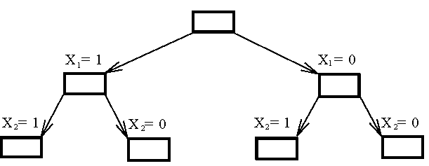
The 0/1 knapsack problem
The Branching Mechanism for the Knapsack Problem.

Slide 46
How to expand the tree?
The best-first search scheme
expand the node with the best lower bound.
If two nodes have the same lower bounds
expand the node with the lower upper bound.

Slide 47
How to find the upper bound?
Ans:
by quickly finding a feasible solution in a greedy manner:
starting from the smallest available i, scanning towards the largest i’s until M is exceeded.
The upper bound can be calculated.

Slide 48
The 0/1 knapsack problem
E.g. n = 6, M = 34
i
1
2
3
4
5
6
P_{i}
6
10
4
5
6
4
W_{i}
10
19
8
10
12
8
(P_{i}/W_{i} ≥ P_{i+1}/W_{i+1})
i
1
2
3
4
5
6
P_{i}/ W_{i}
0.6
0.53
0.5
0.5
0.5
0.5
A feasible solution?

Slide 49
The 0/1 knapsack problem
E.g. n = 6, M = 34
i
1
2
3
4
5
6
P_{i}
6
10
4
5
6
4
W_{i}
10
19
8
10
12
8
(P_{i}/W_{i} ≥ P_{i+1}/W_{i+1})
A feasible solution:
x₁ = 1, x₂ = 1, x₃ = 0, x₄ = 0, x₅ = 0, x₆ = 0
-(p₁+p₂) = -16 (upper bound)
Any solution higher than -16 can not be an optimal solution.

Slide 50
How to find the lower bound?
Ans:
by relaxing our restriction from X_{i} = 0 or 1 to 0 ≤ X_{i} ≤ 1 (knapsack problem)

Slide 51
The knapsack problem
i | 1 | 2 | 3 | 4 | 5 | 6
P_{i} | 6 | 10 | 4 | 5 | 6 | 4
W_{i} | 10 | 19 | 8 | 10 | 12 | 8
We can use the greedy method to find an optimal solution for knapsack problem.
For example, for the state of x₁=1 and x₂=1, we have
x₁ = 1, x₂ =1,
x₃ = (34 -10 - 19)/8 = 5/8,
x₄ = 0, x₅ = 0, x₆ = 0
-(p₁+p₂+5/8p₃) = -18.5 (lower bound)
-18 is our lower bound.
consider only integers for a 0/1 knapsack problem.)

Slide 52
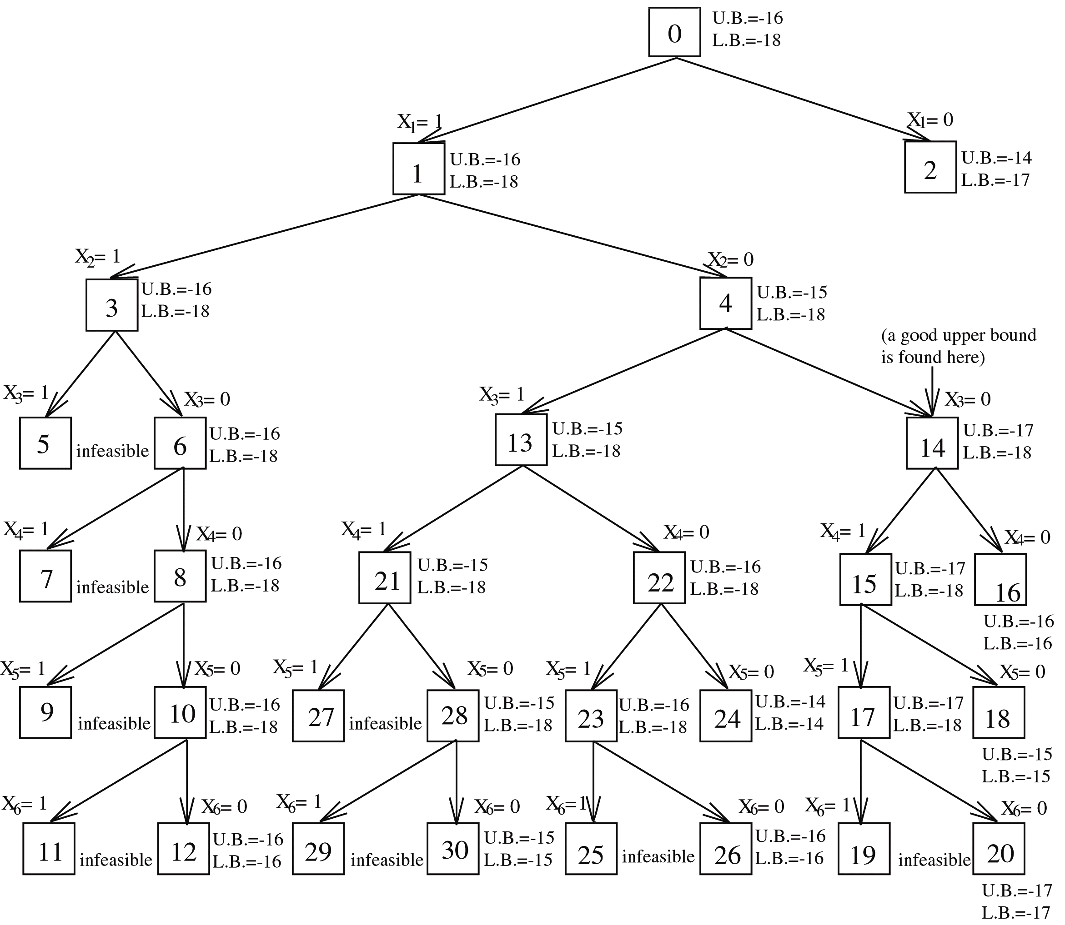
i | 1 | 2 | 3 | 4 | 5 | 6
P_{i} | 6 | 10 | 4 | 5 | 6 | 4
W_{i} | 10 | 19 | 8 | 10 | 12 | 8
For the state of x₁=0 and x₂=1, x₃ = 1, we have
x₁ = 0, x₂ =1, x₃ = 1,
-(p₂ + p₃) = -(10 + 4) = -14 (UB)
x₄ = (34 -19 - 8)/10 = 7/10,
x₅ = 0, x₆ = 0
-(UB + 7/10p₄) = -17 (LB)

Slide 53
i | 1 | 2 | 3 | 4 | 5 | 6
P_{i} | 6 | 10 | 4 | 5 | 6 | 4
W_{i} | 10 | 19 | 8 | 10 | 12 | 8
x₁ = 1, x₂ = 0, x₃ = 1, x₄ = 1
-(p₁ +p₃ +p₄) = -(6 + 4 + 5) = -15 (UB)
x₅ = (34 -10 – 8 - 10)/12 = 6/12,
x₆ = 0
-(UB+6/12p₅) = -18 (LB)

Slide 54
i | 1 | 2 | 3 | 4 | 5 | 6
P_{i} | 6 | 10 | 4 | 5 | 6 | 4
W_{i} | 10 | 19 | 8 | 10 | 12 | 8

Slide 55
Node 2 is terminated because its lower bound is equal to the upper bound of node 14.
Nodes 16, 18 and others are terminated because the local lower bound is equal to the local upper bound. (lower bound ≤ optimal solution ≤ upper bound)

Slide 56
The knapsack problem
Algorithm Bound(cp,cw,k)
//cp, cw are current profit and current weight
//k is the idex of the last removed item
{
b:= cp; c= cw;
for i:= k + 1 to n do
{
c:= c + w[i];
if(c < m) then b:= b + p[i];
else return b + (1 – (c-m)/w[i])*p[i];
}
return b;
}

Slide 57
The knapsack problem
Algorithm Ubound(cp,cw,k,w)
//cp, cw are current profit and current weight
//k is the idex of the last removed item
{
b:= cp; c= cw;
for i:= k + 1 to n do
{
if(c + w[i] <= m) then
{
c:= c + w[i];
b:= b – p[i];
}
}
}

Slide 58
knapsack problem: m =15
i | 1 | 2 | 3 | 4
P_{i} | 10 | 10 | 12 | 18
W_{i} | 2 | 4 | 6 | 9
P_{i}/W_{i} | 5 | 2.5 | 2 | 2
 | 1 | 1 | 1 | 0
x₁ = 1, x₂ =1, x₃ =1
upper bound : -(p₁ + p₂ + p3 ) = - 32
x₄ = (15-2-4-6)/9 = 1/3
lower bound : -(p₁ + p₂ + p3 + 1/3p₄) = - 38

Slide 59
knapsack problem: m =15
i | 1 | 2 | 3 | 4
P_{i} | 10 | 10 | 12 | 18
W_{i} | 2 | 4 | 6 | 9
1
LB:
-38
UB:
-32
x₁= 1
x₁= 0
2
LB:
-38
3
LB:
-32
UB:
-32
UB:
-22
x₂= 1
x₂= 0
4
LB:
-38
5
LB:
-36
UB:
-32
UB:
-22
x₃= 1
x₃= 0
6
LB:
-38
7
LB:
-38
UB:
-32
UB:
-38
x₄= 1
x₄= 0
8
LB:
-38
9
LB:
-20
UB:
-38
UB:
-20

Slide 60
knapsack problem: m =15
i | 1 | 2 | 3 | 4
P_{i} | 10 | 10 | 12 | 18
W_{i} | 2 | 4 | 6 | 9
1
LB:
-38
UB:
-32
x₁= 1
x₁= 0
2
LB:
-38
3
LB:
-32
UB:
-32
UB:
-22
x₁ = 0, x₂ =1, x₃ =1
upper bound : - ( p₂ + p3 ) = - 22
x₄ = (15-4-6)/9 = 5/9
lower bound : - (p₂ + p3 + 5/9p₄) = - 32

Slide 61
knapsack problem: m =15
i | 1 | 2 | 3 | 4
P_{i} | 10 | 10 | 12 | 18
W_{i} | 2 | 4 | 6 | 9
1
LB:
-38
UB:
-32
x₁= 1
x₁= 0
2
LB:
-38
3
LB:
-32
UB:
-32
UB:
-22
x₂= 1
x₂= 0
4
LB:
-38
5
LB:
-36
UB:
-32
UB:
-22
x₁ = 1, x₂ =0, x₃ =1
upper bound : - (p₁ + p3 ) = - 22
x₄ = (15-2-6)/9 = 7/9
lower bound : - (p₁ + p3 + 5/9p₄) = - 36

Slide 62
knapsack problem: m =15
i | 1 | 2 | 3 | 4
P_{i} | 10 | 10 | 12 | 18
W_{i} | 2 | 4 | 6 | 9
1
LB:
-38
UB:
-32
x₁= 1
x₁= 0
2
LB:
-38
3
LB:
-32
UB:
-32
UB:
-22
x₂= 1
x₂= 0
4
LB:
-38
5
LB:
-36
UB:
-32
UB:
-22
x₃= 1
x₃= 0
LB:
-38
LB:
-38
x₁=1, x₂=1,
x₃=0, x₄=0
6
7
UB:
-32
UB:
-38
upper bound : - (p₁ + p2 + p₄ ) = - 38

Slide 63
knapsack problem: m =15
i | 1 | 2 | 3 | 4
P_{i} | 10 | 10 | 12 | 18
W_{i} | 2 | 4 | 6 | 9
1
LB:
-38
UB:
-32
x₁= 1
x₁= 0
2
LB:
-38
3
LB:
-32
UB:
-32
UB:
-22
x₂= 1
x₂= 0
4
LB:
-38
5
LB:
-36
UB:
-32
UB:
-22
x₃= 1
x₃= 0
LB:
-38
LB:
-38
x₁=1, x₂=1,
x₃=0, x₄=1
6
7
UB:
-32
UB:
-38
x₄= 1
LB:
-38
upper bound : - (p₁ + p2 + p₄ ) = - 38
8
UB:
-38

Slide 64
knapsack problem: m =15
i | 1 | 2 | 3 | 4
P_{i} | 10 | 10 | 12 | 18
W_{i} | 2 | 4 | 6 | 9
1
LB:
-38
UB:
-32
x₁= 1
x₁= 0
2
LB:
-38
3
LB:
-32
UB:
-32
UB:
-22
x₂= 1
x₂= 0
4
LB:
-38
5
LB:
-36
UB:
-32
UB:
-22
x₃= 1
x₃= 0
x₁=1, x₂=1,
x₃=0, x₄=0
6
LB:
-38
7
LB:
-38
UB:
-32
UB:
-38
upper bound :
- (p₁ + p2 ) = - 20
x₄= 1
x₄= 0
8
LB:
-38
9
LB:
-20
UB:
-38
UB:
-20

Slide 65
The Job Assignment Problem
Given n tasks and n agents.
Each agent has a cost to complete each task.
If the agent is not able to complete the task, the cost is ∞.
Assign each agent a task to minimize cost.

Slide 66
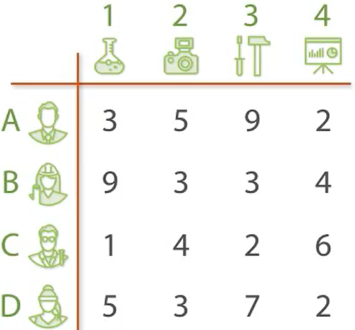
The Job Assignment Problem

Slide 67
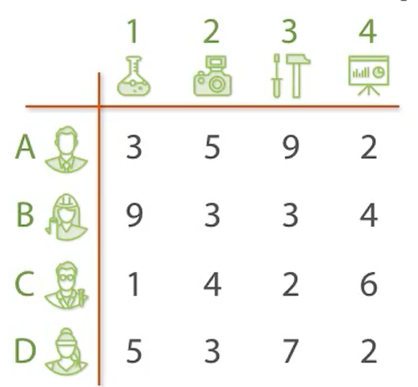
The Task Assignment Problem
Best so far: ∞

Slide 68
The Task Assignment Problem
Best so far: 10
(1, 2, 3, 4)

Slide 69

The Task Assignment Problem
1
2
3
4
Best so far: 10
(1, 2, 3, 4)

Slide 70
The Task Assignment Problem
LB :9
1
2
3
4
Best so far: 10
(1, 2, 3, 4)

Slide 71
The Task Assignment Problem
LB :9
LB :11
1
2
3
4
Best so far: 10
(1, 2, 3, 4)

Slide 72
The Task Assignment Problem
LB :9
LB :11
LB :15
1
2
3
4
Best so far: 10
(1, 2, 3, 4)

Slide 73
The Task Assignment Problem
LB :9
LB :11
LB :15
LB :8
1
2
3
4
Best so far: 10
(1, 2, 3, 4)

Slide 74
The Task Assignment Problem
LB :9
LB :11
LB :15
LB :8
1
2
3
4
Best so far: 10
(1, 2, 3, 4)
Priority queue
1…, LB:9
4…, LB:8

Slide 75
The Task Assignment Problem
4…, LB:8
LB :9
LB :11
LB :15
LB :8
1
2
3
4
1
2
3
Best so far: 10
(1, 2, 3, 4)
Priority queue
1…, LB:9

Slide 76
The Task Assignment Problem
4…, LB:8
LB :9
LB :11
LB :15
LB :8
1
2
3
4
LB :14
1
2
3
Best so far: 10
(1, 2, 3, 4)
Priority queue
1…, LB:9

Slide 77
The Task Assignment Problem
4…, LB:8
LB :9
LB :11
LB :15
LB :8
1
2
3
4
LB :14
LB :8
1
2
3
Best so far: 10
(1, 2, 3, 4)
Priority queue
1…, LB:9

Slide 78
The Task Assignment Problem
LB :9
LB :11
LB :15
LB :8
1
2
3
4
LB :14
LB :8
LB :8
1
2
3
Best so far: 10
(1, 2, 3, 4)
Priority queue
1…, LB:9

Slide 79
The Task Assignment Problem
LB :9
LB :11
LB :15
LB :8
1
2
3
4
LB :14
LB :8
LB :8
1
2
3
Best so far: 10
(1, 2, 3, 4)
Priority queue
1…, LB:9
4,3…, LB:8
4,2…, LB:8

Slide 80
The Task Assignment Problem
4,2…, LB:8
LB :9
LB :11
LB :15
LB :8
1
2
3
4
LB :14
LB :8
LB :8
1
2
3
Best so far: 10
(1, 2, 3, 4)
1
3
Priority queue
1…, LB:9
4,3…, LB:8

Slide 81
The Task Assignment Problem
4,2…, LB:8
LB :9
LB :11
LB :15
LB :8
1
2
3
4
LB :14
LB :8
LB :8
1
2
3
Best so far: 10
LB :8
(1, 2, 3, 4)
1
3
Priority queue
1…, LB:9
4,3…, LB:8

Slide 82
The Task Assignment Problem
4,2…, LB:8
LB :9
LB :11
LB :15
LB :8
1
2
3
4
LB :14
LB :8
LB :8
1
2
3
Best so far: 10
LB :8
LB :9
(1, 2, 3, 4)
1
3
Priority queue
1…, LB:9
4,3…, LB:8

Slide 83
The Task Assignment Problem
LB :9
LB :11
LB :15
LB :8
1
2
3
4
LB :14
LB :8
LB :8
1
2
3
Best so far: 10
LB :8
LB :9
(1, 2, 3, 4)
1
3
Priority queue
1…, LB:9
4,3…, LB:8
4,2,1…, LB:8
4,2,3…, LB:8

Slide 84
The Task Assignment Problem
4,3…, LB:8
LB :9
LB :11
LB :15
LB :8
1
2
3
4
LB :14
LB :8
1
2
LB :8
3
Best so far: 10
LB :8
LB :9
(1, 2, 3, 4)
1
3
Priority queue
1…, LB:9
4,2,1…, LB:8
4,2,3…, LB:8

Slide 85
The Task Assignment Problem
4,3…, LB:8
LB :9
LB :11
LB :15
LB :8
1
2
3
4
LB :14
LB :8
1
2
LB :8
3
Best so far: 10
LB :8
LB :9
LB :8
(1, 2, 3, 4)
1
3
1
2
Priority queue
1…, LB:9
4,2,1…, LB:8
4,2,3…, LB:8

Slide 86
The Task Assignment Problem
4,3…, LB:8
LB :9
LB :11
LB :15
LB :8
1
2
3
4
LB :14
LB :8
1
2
LB :8
3
Best so far: 10
LB :8
LB :9
LB :8
LB :11
(1, 2, 3, 4)
1
3
1
2
Priority queue
1…, LB:9
4,2,1…, LB:8
4,2,3…, LB:8

Slide 87
The Task Assignment Problem
LB :9
LB :11
LB :15
LB :8
1
2
3
4
LB :14
LB :8
1
2
LB :8
3
Best so far: 10
LB :8
LB :9
LB :8
LB :11
(1, 2, 3, 4)
1
3
1
2
Priority queue
1…, LB:9
4,2,1…, LB:8
4,2,3…, LB:8
4,3,1…, LB:8

Slide 88
The Task Assignment Problem
4,2,1…, LB:8
LB :9
LB :11
LB :15
LB :8
1
2
3
4
LB :14
LB :8
1
2
LB :8
3
Best so far: 10
LB :8
LB :9
LB :8
LB :11
(1, 2, 3, 4)
1
3
1
2
Priority queue
1…, LB:9
LB :13
4,2,3…, LB:8
3
4,3,1…, LB:8

Slide 89
The Task Assignment Problem
LB :9
LB :11
LB :15
LB :8
1
2
3
4
LB :14
LB :8
1
2
LB :8
3
Best so far: 10
LB :8
LB :9
LB :8
LB :11
(1, 2, 3, 4)
1
3
1
2
Priority queue
1…, LB:9
LB :13
4,2,3…, LB:8
3
4,3,1…, LB:8

Slide 90
The Task Assignment Problem
4,3,1…, LB:8
LB :9
LB :11
LB :15
LB :8
1
2
3
4
LB :14
LB :8
1
2
LB :8
3
Best so far: 10
LB :8
LB :9
LB :8
LB :11
(1, 2, 3, 4)
1
3
1
2
Priority queue
1…, LB:9
LB :13
LB :9
4,2,3…, LB:8
3
2

Slide 91
The Task Assignment Problem
LB :9
LB :11
LB :15
LB :8
1
2
3
4
LB :14
LB :8
1
2
LB :8
3
Best so far: 9
LB :8
LB :9
LB :8
LB :11
(4,3,1,2)
1
3
1
2
Priority queue
1…, LB:9
LB :13
LB :9
4,2,3…, LB:8
3
2

Slide 92
The Task Assignment Problem
1…, LB:9
LB :9
LB :11
LB :15
LB :8
1
2
3
4
LB :14
LB :8
1
2
LB :8
3
Best so far: 9
LB :8
LB :9
LB :8
LB :11
(4,3,1,2)
1
3
1
2
Priority queue
LB :13
LB :9
4,2,3…, LB:8
3
2

Slide 93
The Task Assignment Problem
4,2,3…, LB:8
LB :9
LB :11
LB :15
LB :8
1
2
3
4
LB :14
LB :8
1
2
LB :8
3
Best so far: 9
LB :8
LB :9
LB :8
LB :11
(4,3,1,2)
1
3
1
2
Priority queue
LB :13
LB :9
3
2

Slide 94
The Task Assignment Problem
LB :9
LB :11
LB :15
LB :8
1
2
3
4
LB :14
LB :8
1
2
LB :8
3
LB :8
LB :9
LB :8
LB :11
Best so far: 9
1
3
1
2
(4,3,1,2)
LB :13
LB :9
Priority queue
3
2

Slide 95
Analysis
Assume n agents and n tasks.
n possible task assignments to first agent followed by n-1 assignments to the next agent.
n *n-1*n-2 …
Θ(n!)
Branch and bound improvement
Depends on the concrete problem and the bounding function.

